Slide 1
The Web Browser War: From Birth to Modern Era

Slide 2
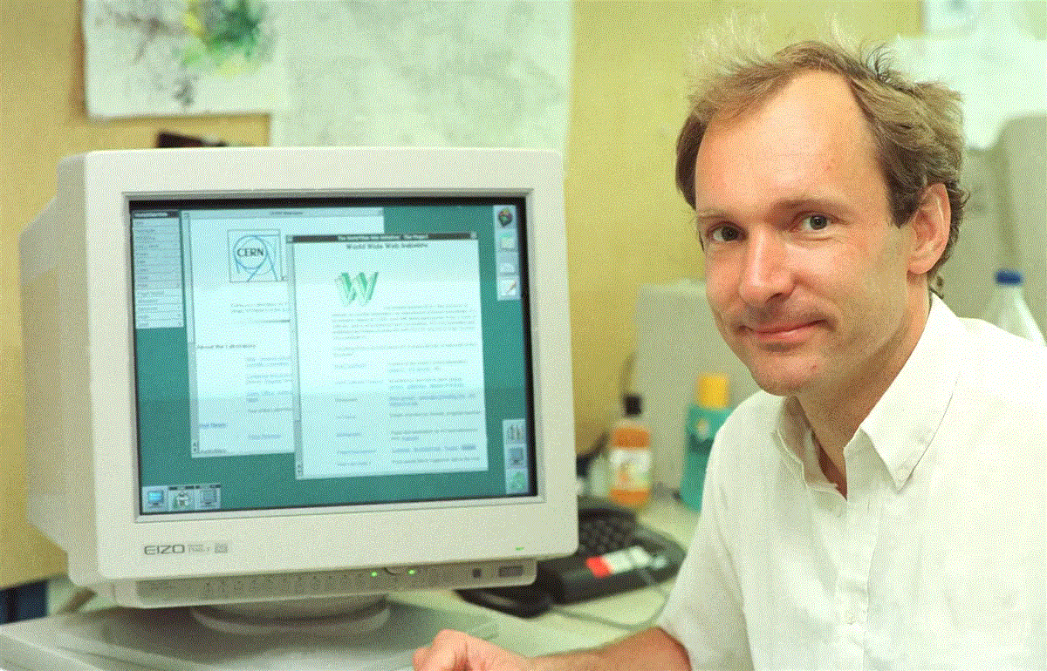

The Birth of the Web
Tim Berners-Lee and the creation of the World Wide Web
The first web browser - "WorldWideWeb" (later renamed Nexus)
The limitations of early web browsers
The impact of the World Wide Web on information access

Slide 3
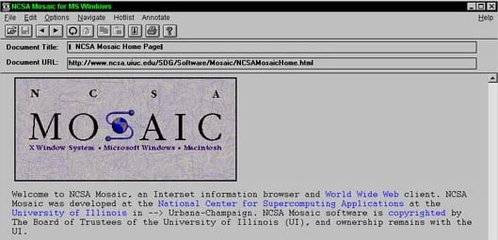
Mosaic's Spark
The development of Mosaic by the National Center for Supercomputing Applications (NCSA)
The introduction of graphical web browsing
The revolutionary feature of inline images
The increased appeal and user-friendliness of the web

Slide 4

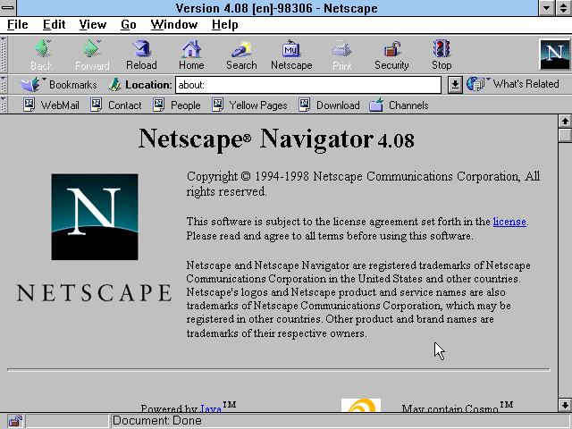
The Rise of Netscape
The inspired by Mosaic, the Netscape Navigator was created.
Marc Andreessen also a co-author of mosaic and his partner Jim Clark, went on to create Netscape Navigator.
With a good mix of features and an attractive licensing scheme that allowed free use for non-commercial purposes.
The user-friendly interface and support for emerging web technologies

Slide 5
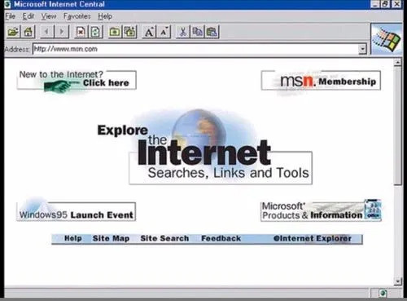
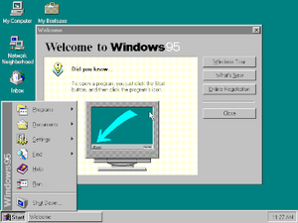
Microsoft's Entry
Microsoft's decision to join the Web Browser War
The release of Internet Explorer as part of Windows 95
The advantage of bundling Internet Explorer with Windows
The beginning of the major battle between Netscape and Microsoft

Slide 6


The Browser Wars Heat Up
The fierce competition between Netscape and Microsoft
The continuous improvement of web browsers with new features and better performance
The rapid development of web technologies during this period
The race to support HTML, CSS, and JavaScript
VS

Slide 7
The Tactics
Microsoft's aggressive tactics to gain an edge
Bundling Internet Explorer with Windows as the default browser
Legal battles over anti-competitive behavior
The impact of these tactics on the Web Browser War

Slide 8

The Fall of Netscape
Netscape's struggle to compete with Microsoft's tactics
The decline of Netscape Navigator's market share
AOL's acquisition of Netscape Communications
The end of an era for Netscape

Slide 9
The Antitrust Battle
The U.S. Department of Justice's antitrust lawsuit against Microsoft
Accusations of abusing monopoly power
Microsoft's guilty verdict and the lasting impact on the company
The implications for the Web Browser War

Slide 10



New Players Emerge
The new turn in the Web Browser War in the new millennium
The release of Firefox by Mozilla as an alternative to Internet Explorer
The introduction of Safari by Apple and Chrome by Google
The advancements in speed, security, and standards compliance

